Slide 1
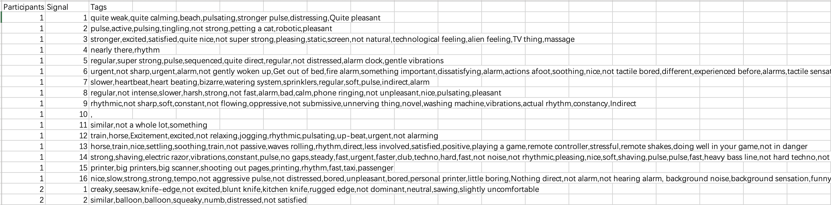
Datasets format
P01.txt to P12.txt contain the descriptions from the 12 participants. Each line has the description for a different signal (e.g., line 1 includes the description for signal 1). 32 signals in total.
Manual_dataset.csv contains the selected phrases (“tags”) from each participant’s description for each signal. Note that if a phrase repeats in the description, all occurrences are considered matches.

Slide 2
Step1: Use GPT-3.5 with fine-tuning method to extract sensational, emotional, metaphoric keywords
Training prompt format:
{"messages":[
{"role": "system", "content": "You are a helpful linguistic assistant. Extract keywords including sensational, emotional, metaphoric, and usage examples from the corresponding texts below: 1. You need to first understand the meaning of the sentence before selection. 2. Remain the negative or positive meaning of the sentences. 3. Only select ADJ and NOUN keywords. 4. Must Remove words \"emotional\", \"sensational\", \"emotion\", \"sensation\", \"feeling\", and their derivatives."},
{"role": "user", "content": ptext_df['Text'].iloc[i] },
{"role": "assistant", "content": cleaned_manual_df['Tags'].iloc[i]} ] }

Slide 3
Step1: Use GPT-3.5 with fine-tuning method to extract sensational, emotional, metaphoric keywords
Divide the data into training and testing sets, with a ratio of 3:7
Testing prompt format: (with no ”assistant” part)
{"messages": [
{"role": "system", "content": "Extract keywords including sensational, emotional, metaphoric, and usage examples from the corresponding texts below."},
{"role": "user", "content": "This feels a little bit more intrusive again. I feel like we're back to the slightly more aggressive ones in a way like it feels a little bit more aggressive. I keep thinking of the sticker again. The sticker stuff, it feels like that. It feels like I expect to take my finger off, and there would be something on my finger that was in the way. It doesn't feel painful or annoying or anything. It's just like there's some kind of obstruction."}],
"Participants": 3,
"Signal": 12}

Slide 4
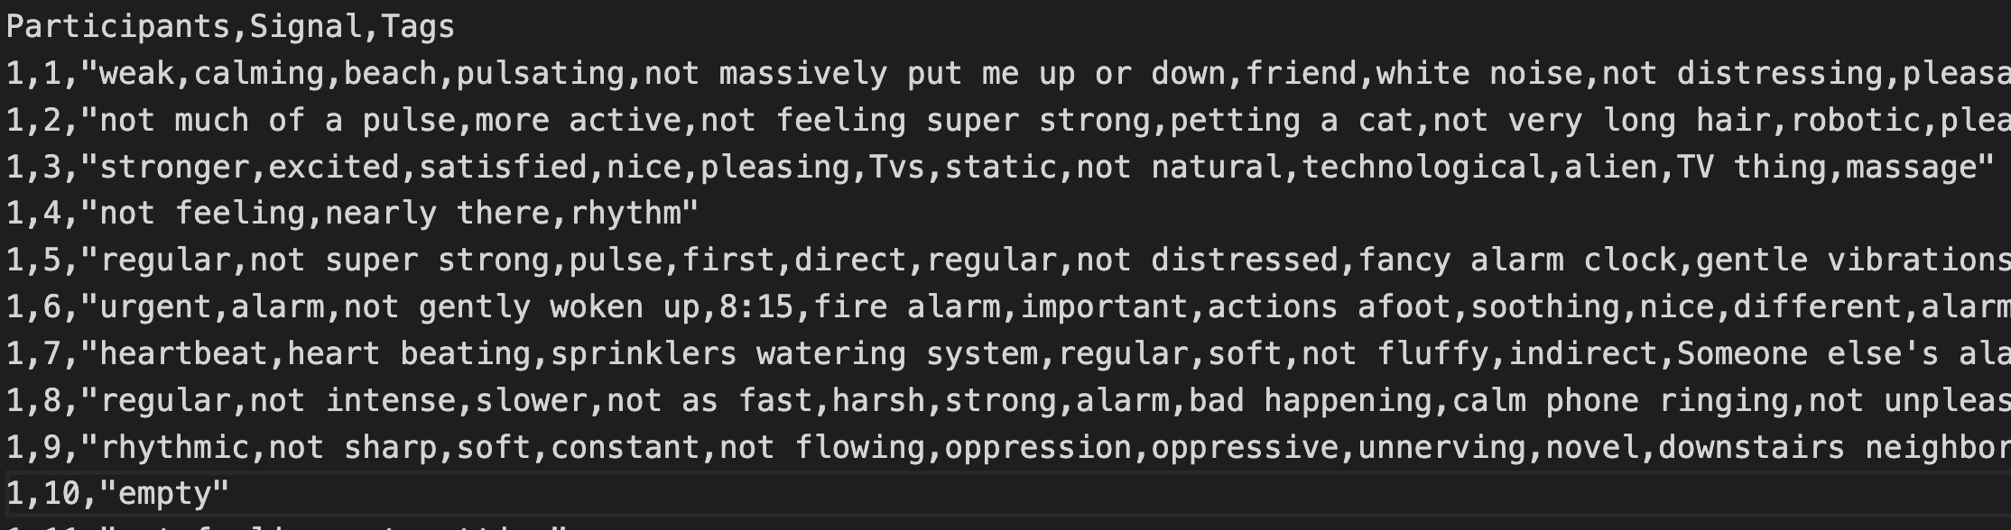
Step1: Use GPT-3.5 with fine-tuning method to extract sensational, emotional, metaphoric keywords
Obtain responses from the model:
response = completion.choices[0].message["content"]
Add Participants, Signal, Tags columns and save to fine_tune_res.csv

Slide 5
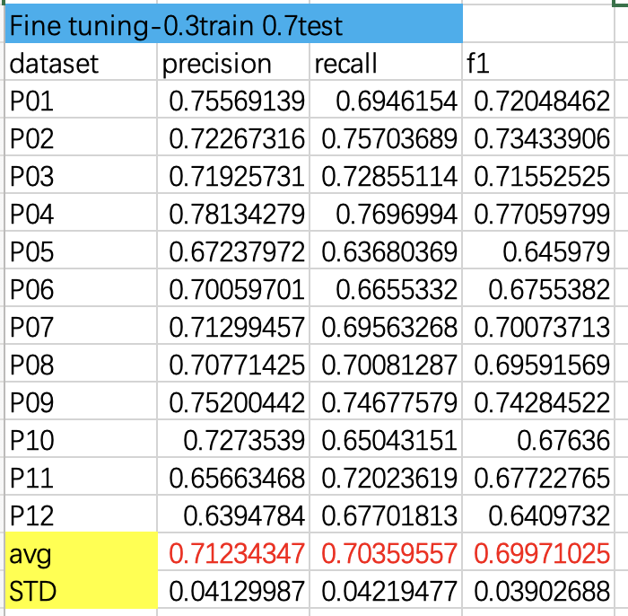
Step2: Calculate strict precision, recall and f1 score of each participants

Slide 6
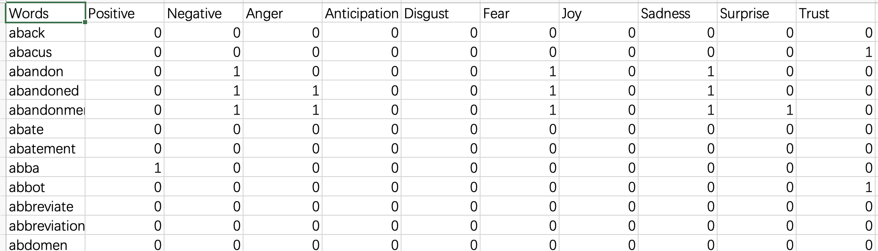
Step3: Keywords further selection --words
Divide into single Words and Phrases
For single Word and “not” word: NRC-Emotion-Lexicon
https://saifmohammad.com/WebPages/NRC-Emotion-Lexicon.htm

Slide 7
Step3: Keywords further selection –words method1
Positive, Anticipation, Joy, Surprise, Trust—”Positive attribute”
Negative, Anger, Disgust, Fear, Sadness, Surprise—”Negative attribute”
If num(pos attribute)>num(neg attribute) -> ”positive”
If num(pos attribute)<num(neg attribute) -> ”negative”
If num(pos attribute)=num(neg attribute)!=0 -> ”positive, negative”
If num(pos attribute)=num(neg attribute)=0 -> “neutral”

Slide 8
Step3: Keywords further selection --words method2:
Positive—”Positive attribute”
Negative—”Negative attribute”
If num(pos attribute)>num(neg attribute) -> ”positive”
If num(pos attribute)<num(neg attribute) -> ”negative”
If num(pos attribute)=num(neg attribute)!=0 -> ”positive, negative”
If num(pos attribute)=num(neg attribute)=0 -> “neutral”

Slide 9
Step3: Keywords further selection –words
Convert all nouns to adjectives, and change comparative and superlative forms back to their base form.
A small number of words were not successfully converted.
WordNetLemmatizer.lemmatize():
Comparative and superlative -> base form
wordnet.synsets.lemmas.derivationally_related_forms():
nouns -> adjectives
Convert uppercase to lowercase. Remove all duplicate words

Slide 10
Step3: Keywords further selection --words
For “not” words, find their antonyms using wordnet.antonyms(), if not find, keep the original form (for GloVe and Word2Vec or add ”un” + words (for FastText).
Before:
Positive:183 Negative: 218 Neutral: 987
Positive:198 Negative: 243
Positive:173 Negative: 203
After:
Positive: 96 Negative: 115
Positive:108 Negative: 132
Positive: 88 Negative: 113
Notes:
173 203 ->88 113
198 243 ->

Slide 11

Step4: word embedding and hierarchical clustering --words
1. GloVe
Pre-train model: glove.840B.300d, based on Common Crawl
https://nlp.stanford.edu/projects/glove/
2. Word2Vec
Pre-train model: GoogleNews-vectors-negative300.bin:
https://code.google.com/archive/p/word2vec/
3. FastText
Pre-train model: wiki.en.bin
https://fasttext.cc/docs/en/crawl-vectors.html
4. ConceptNet Numberbatch
Pre-train model: ConceptNet Numberbatch 19.08
https://github.com/commonsense/conceptnet-numberbatch

Slide 12
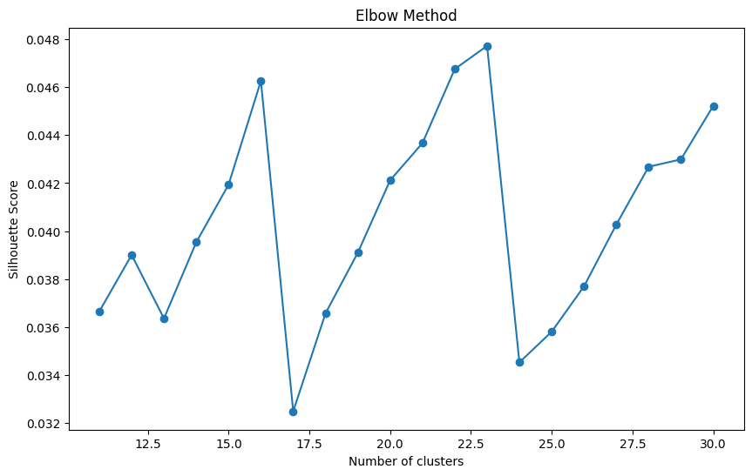
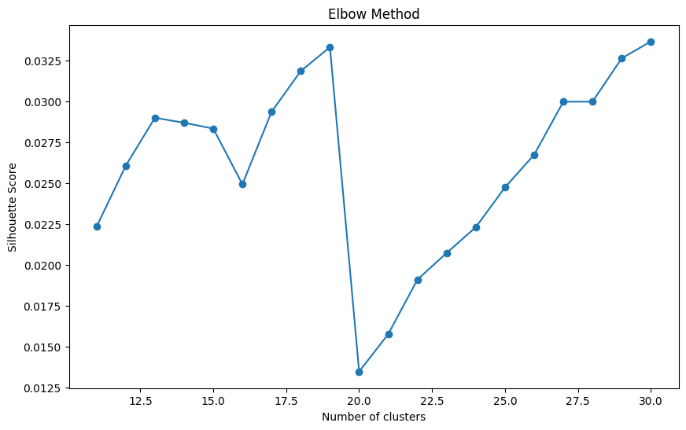
Step4: word embedding and hierarchical clustering --phrases
GloVe-method1:

Slide 13
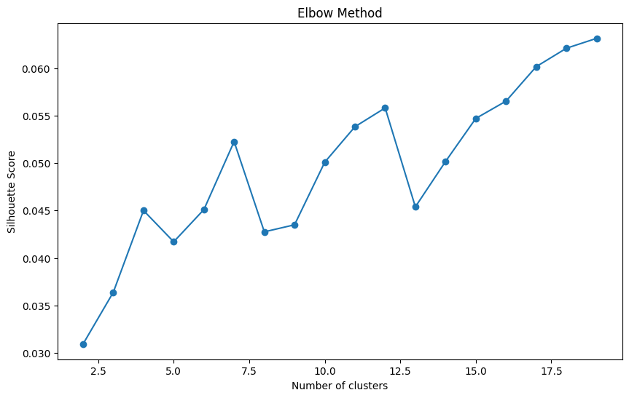
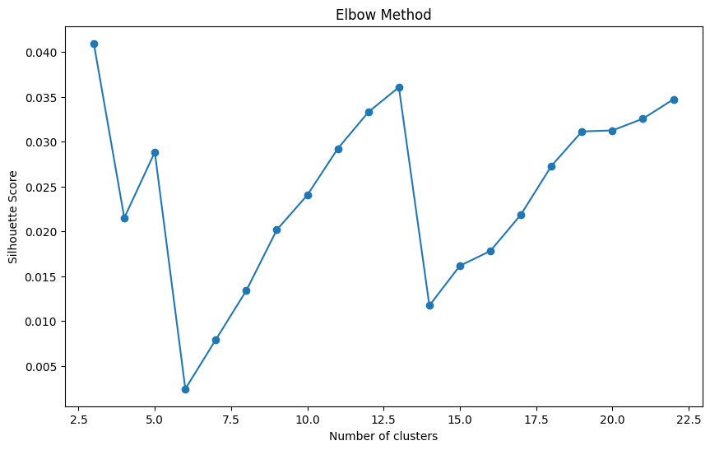
Step4: word embedding and hierarchical clustering --phrases
GloVe-method2:

Slide 14
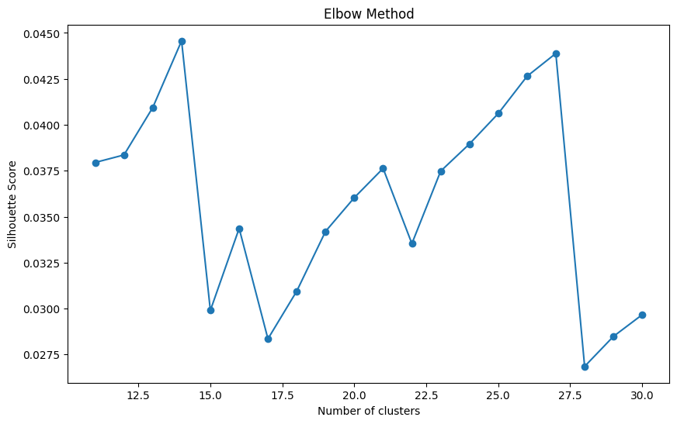
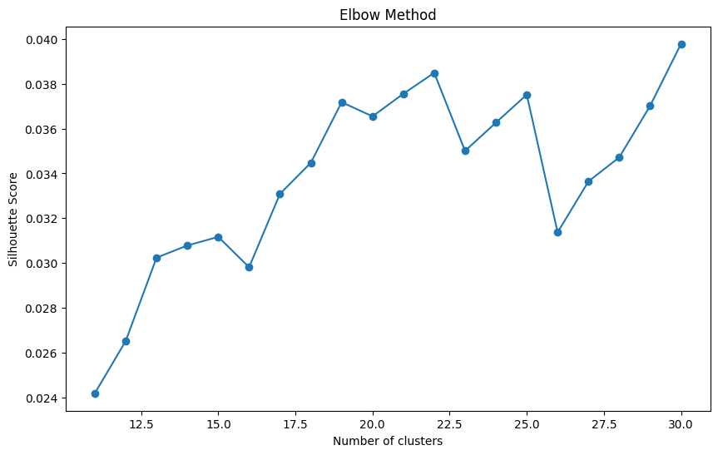
Step4: word embedding and hierarchical clustering --phrases
Word2Vec-method1:

Slide 15
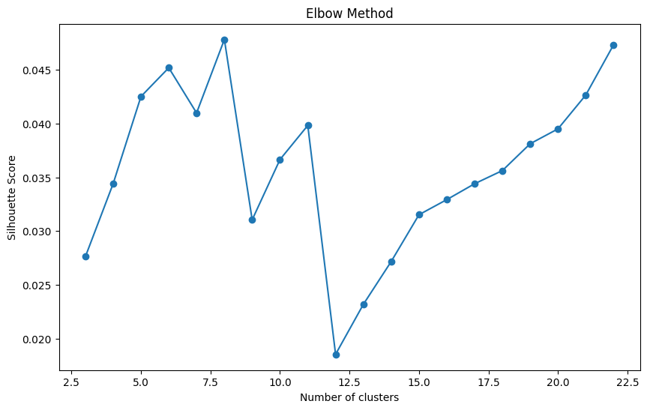
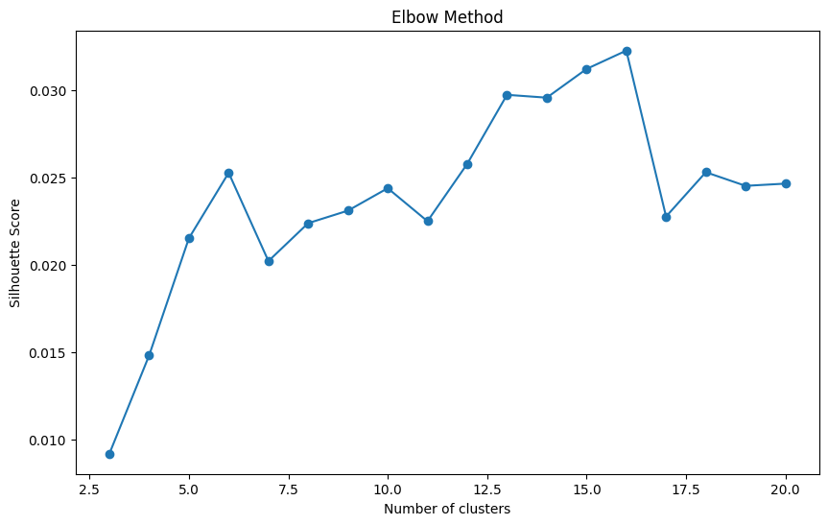
Step4: word embedding and hierarchical clustering --phrases
Word2Vec-method2:

Slide 16
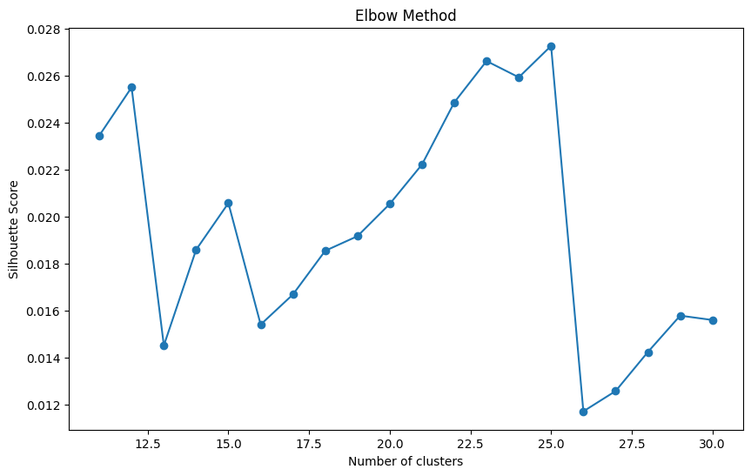
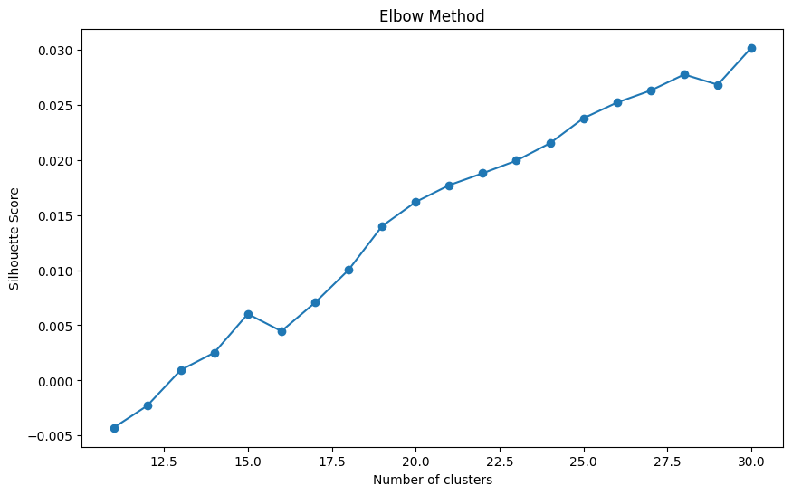
Step4: word embedding and hierarchical clustering --phrases
FastText-method1:

Slide 17
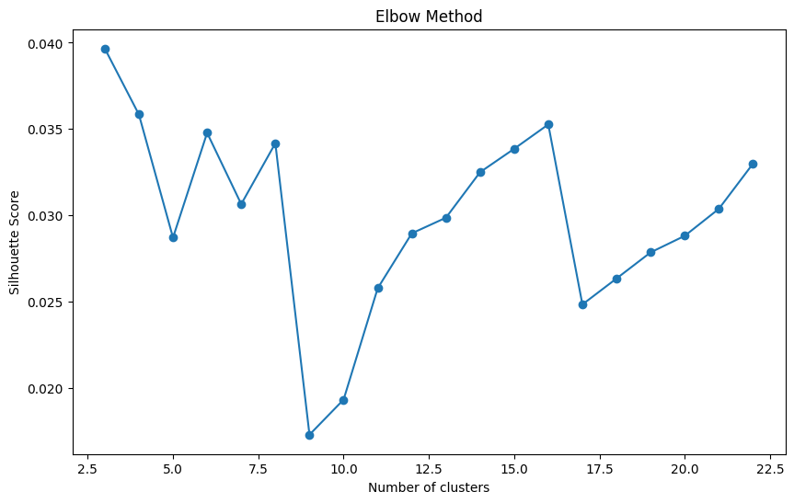
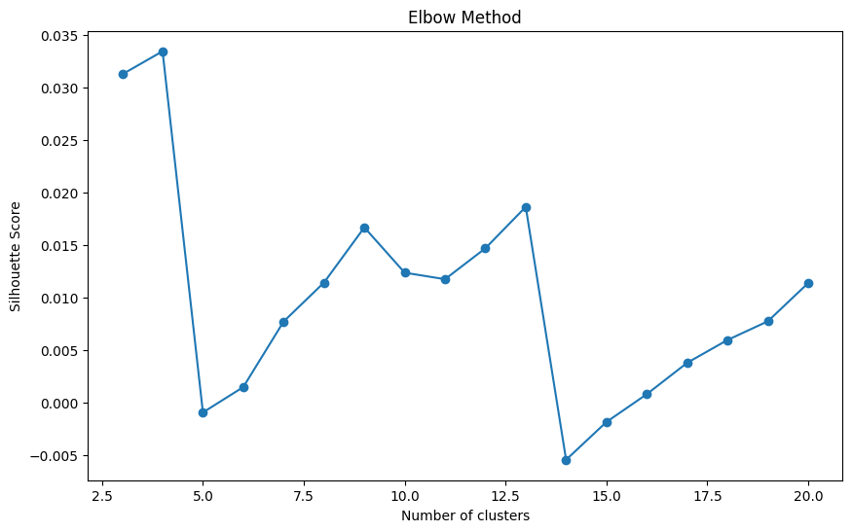
Step4: word embedding and hierarchical clustering --phrases
FastText-method2:

Slide 18
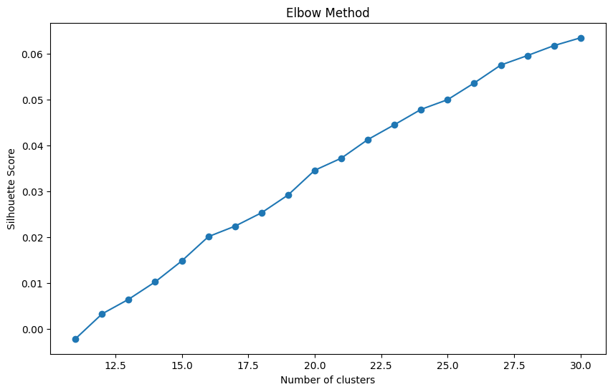
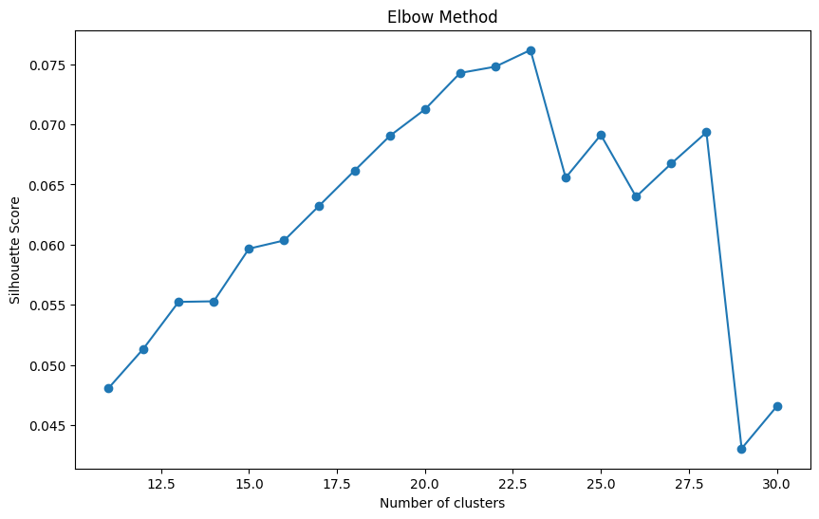
Step4: word embedding and hierarchical clustering --phrases
ConceptNet Numberbatch

Slide 19
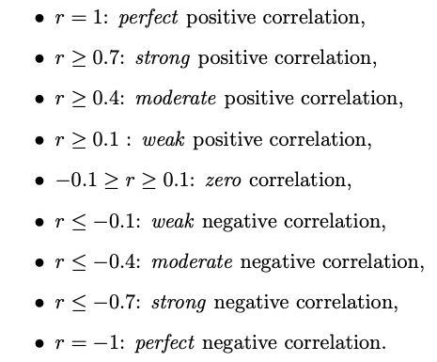
Step 5: Correlation between signal patterns and Clusters:
n_clusters | GloVe | Word2Vec | FastText | ConceptNet
positive | 14 | 14 | 14 | 14
negative | 15 | 15 | 15 | 15
n_clusters | GloVe | Word2Vec | FastText | ConceptNet
positive | 12 | 12 | 12 | 12
negative | 13 | 13 | 13 | 13
Seven signal patterns: mean_amplitude, rms, pulse_count, std_pulse_dist, zero_count, mean_onset_strength, spectral_centroid

Slide 20
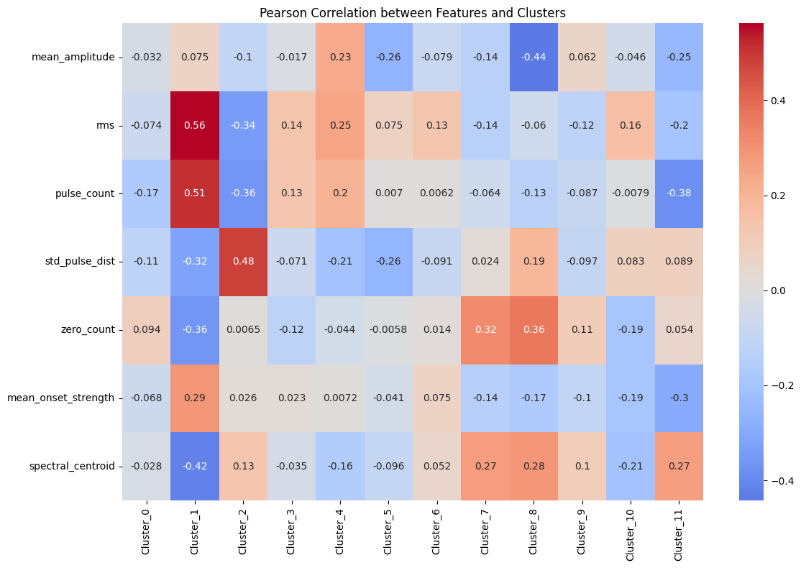
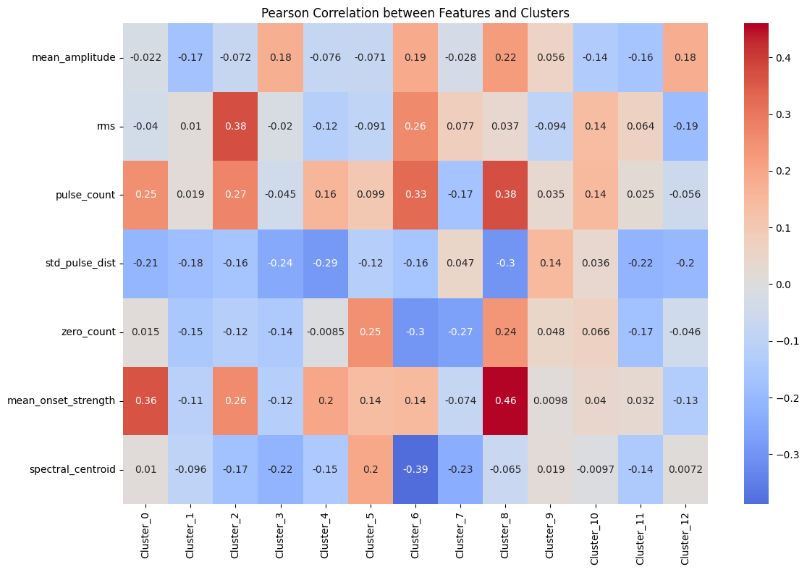
GloVe-before
Positive
Negative

Slide 21
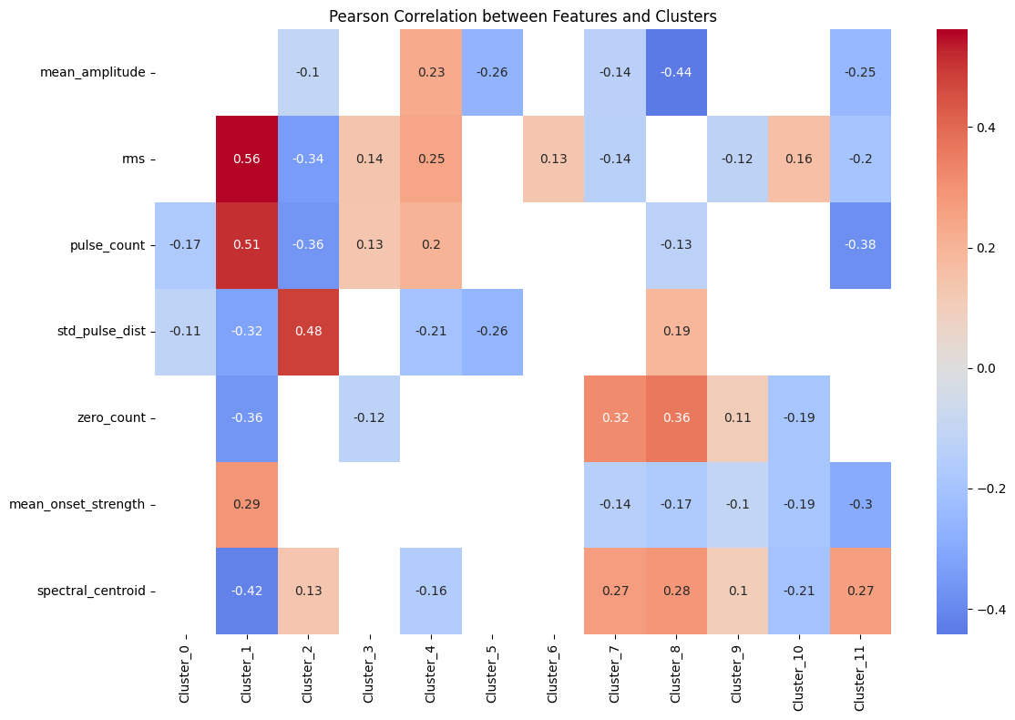
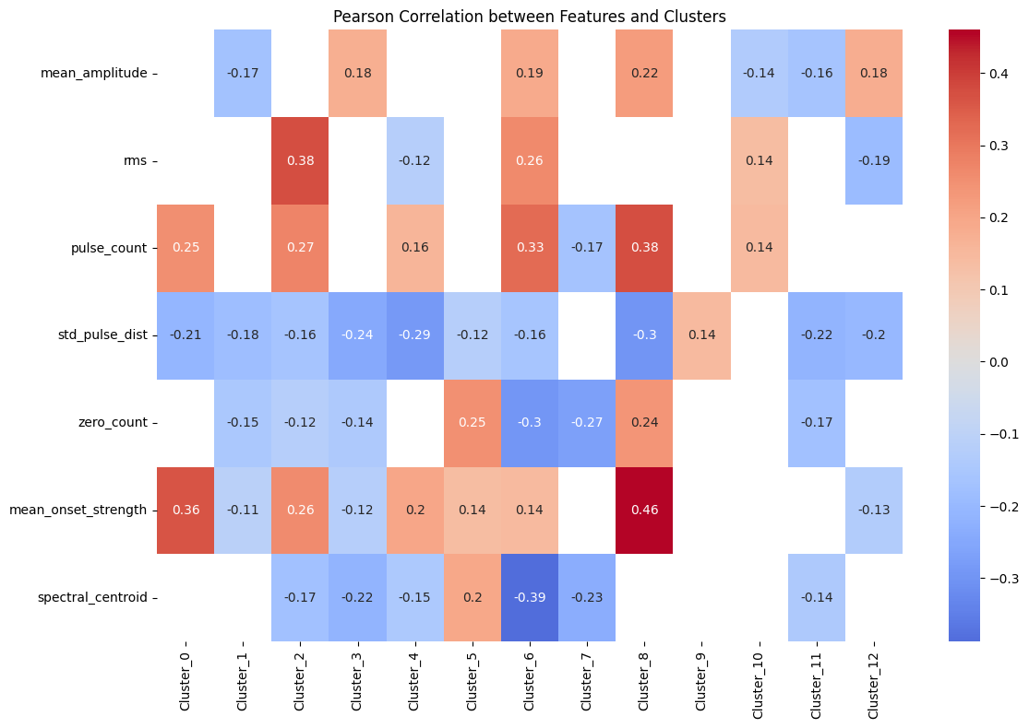
GloVe
Positive
Negative

Slide 22
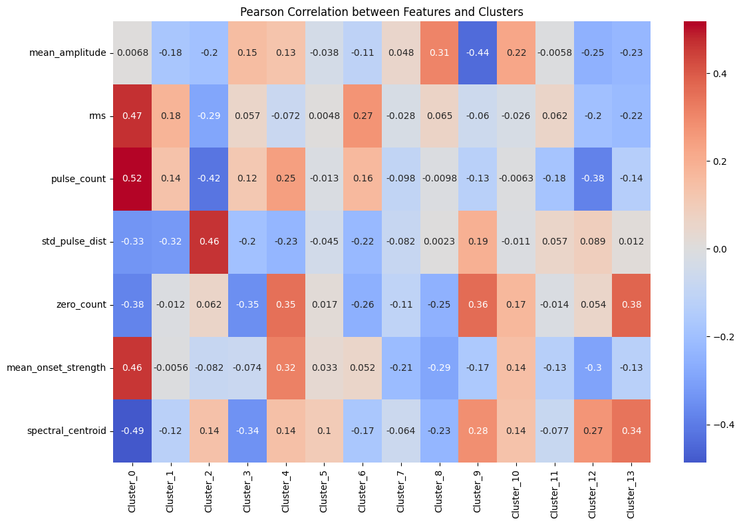
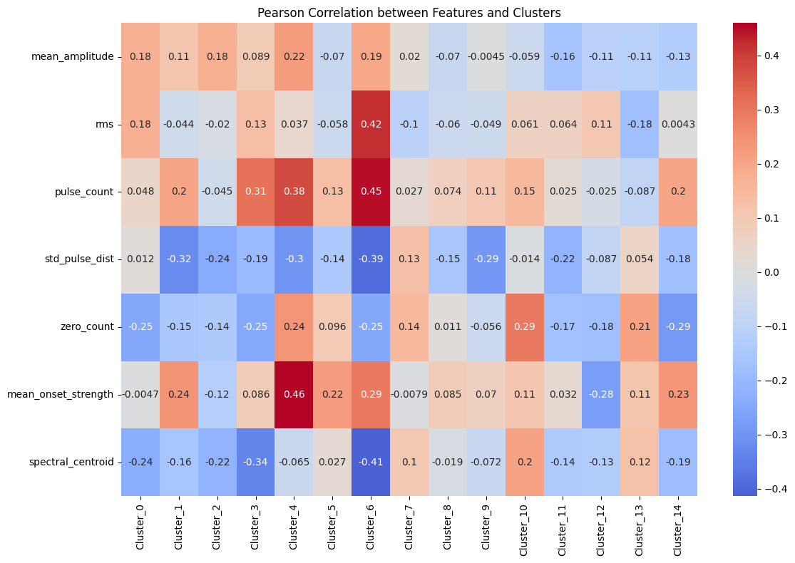
GloVe-after1
Positive
Negative

Slide 23
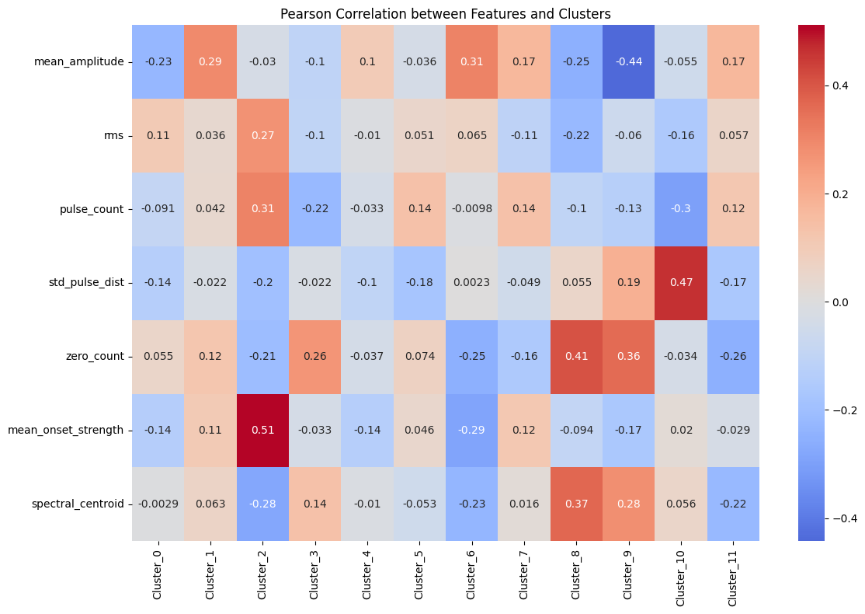
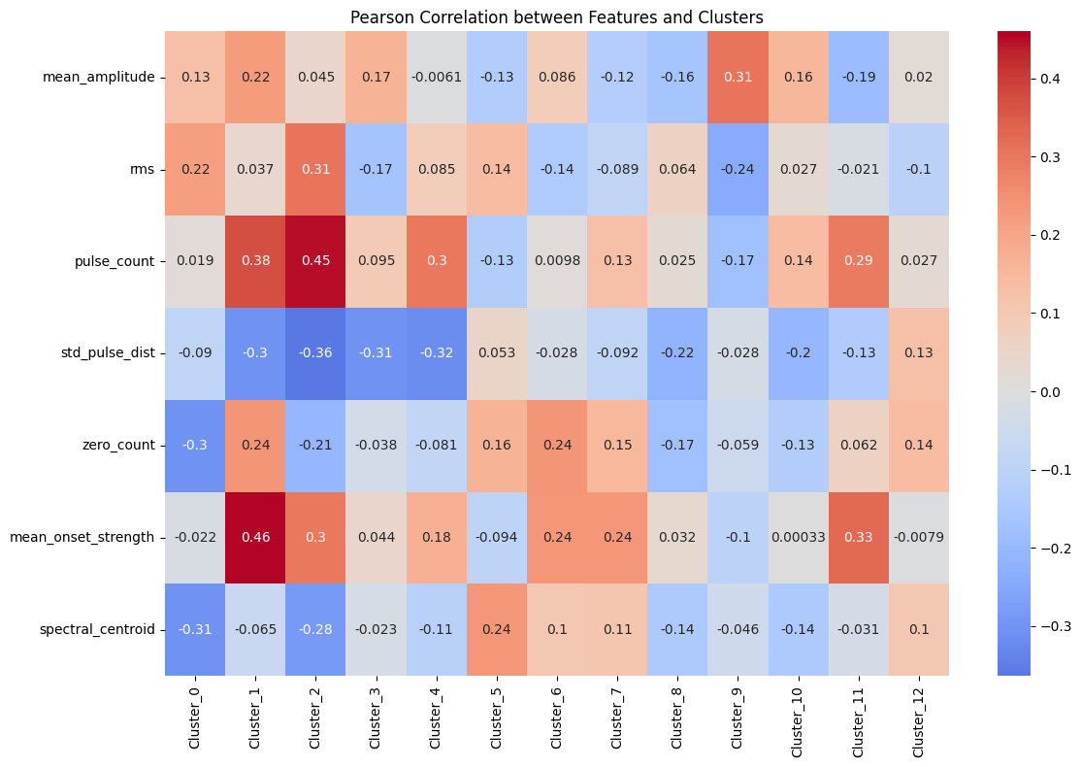
GloVe-after2
Negative
Positive

Slide 24
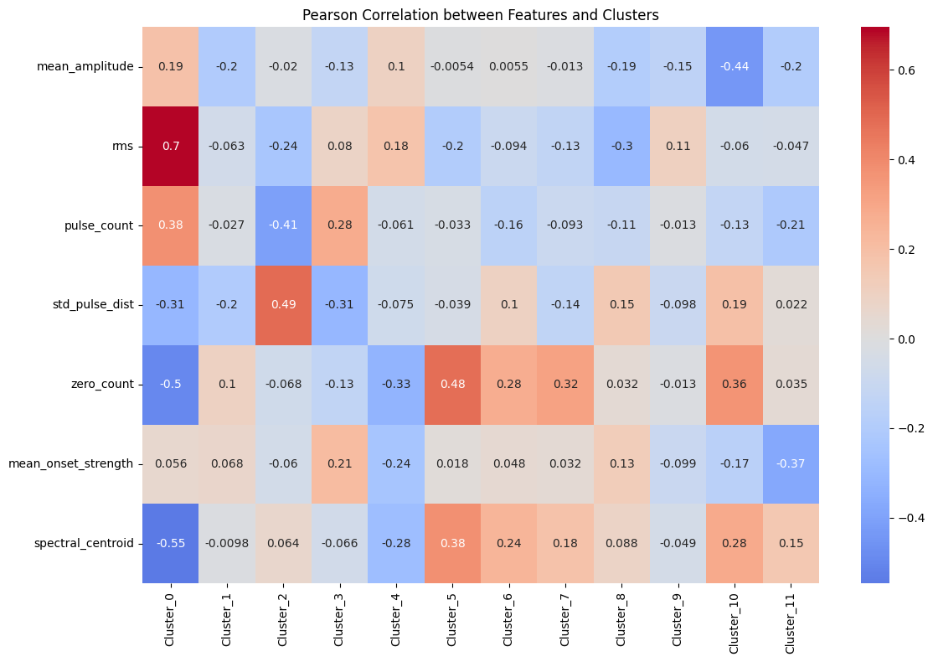
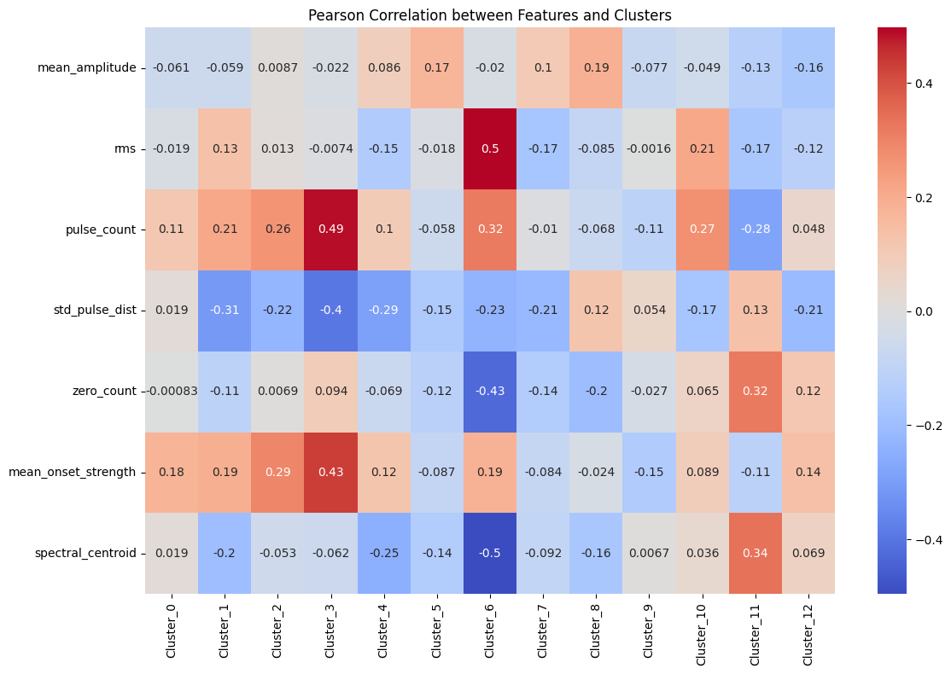
Word2Vec-before
Positive
Negative

Slide 25
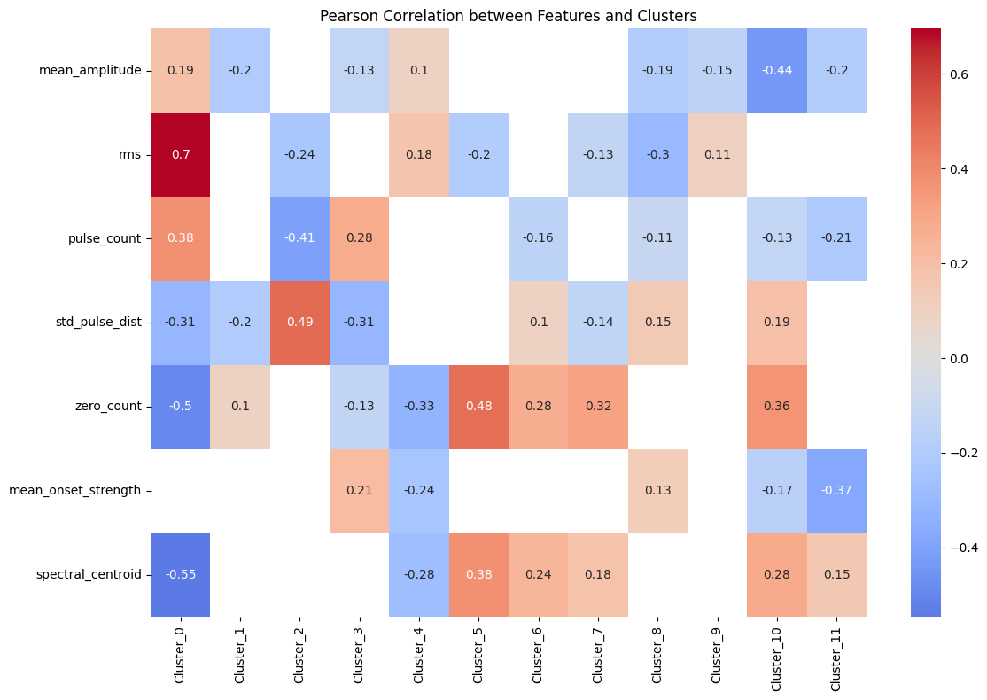
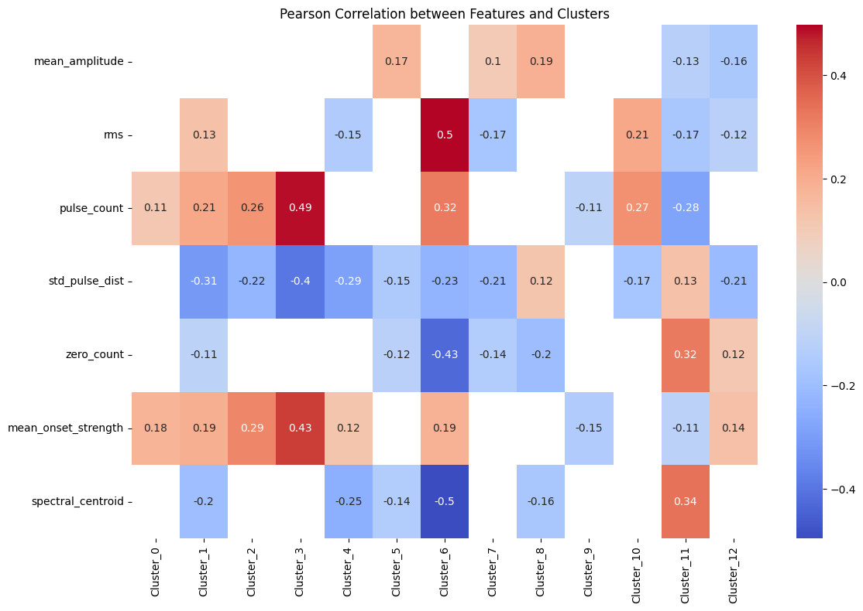
Word2Vec
Positive
Negative

Slide 26
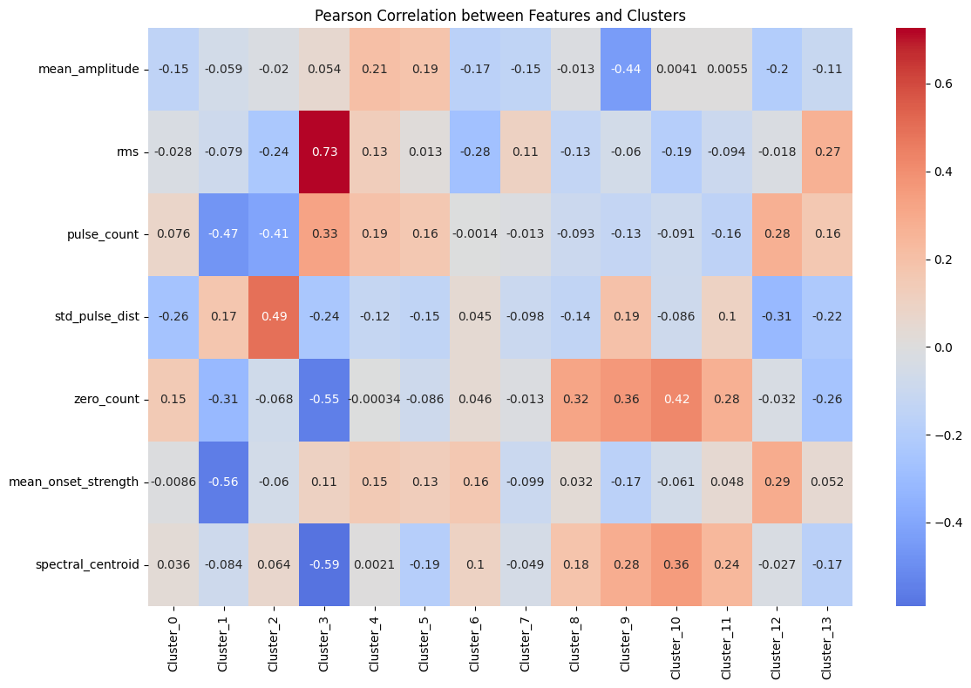
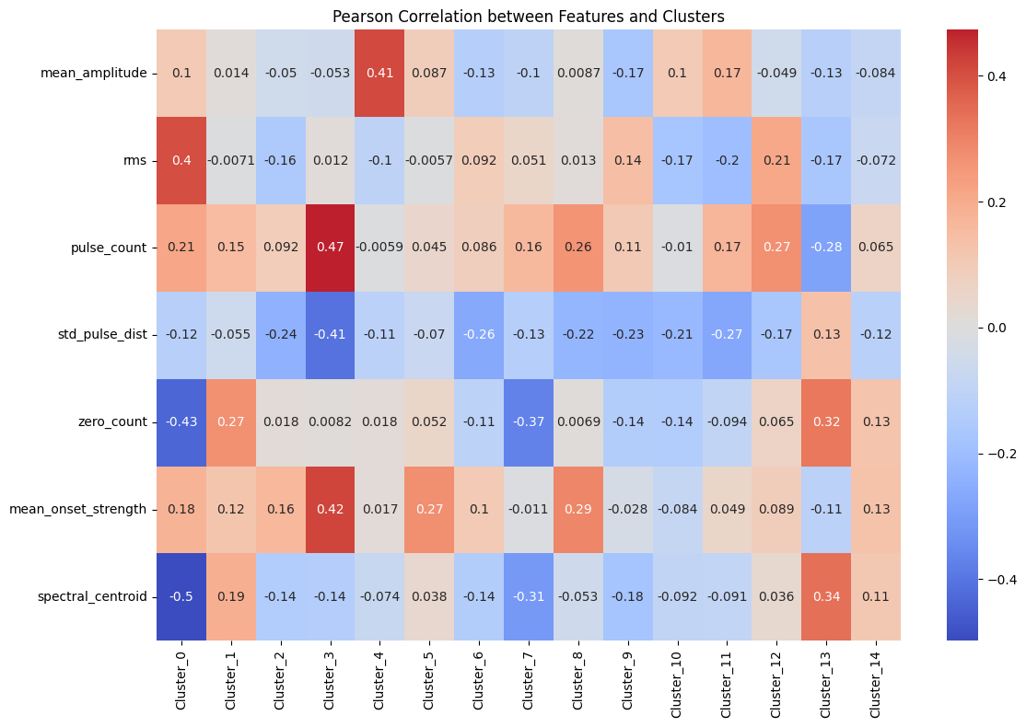
Word2Vec-after1
Positive
Negative

Slide 27
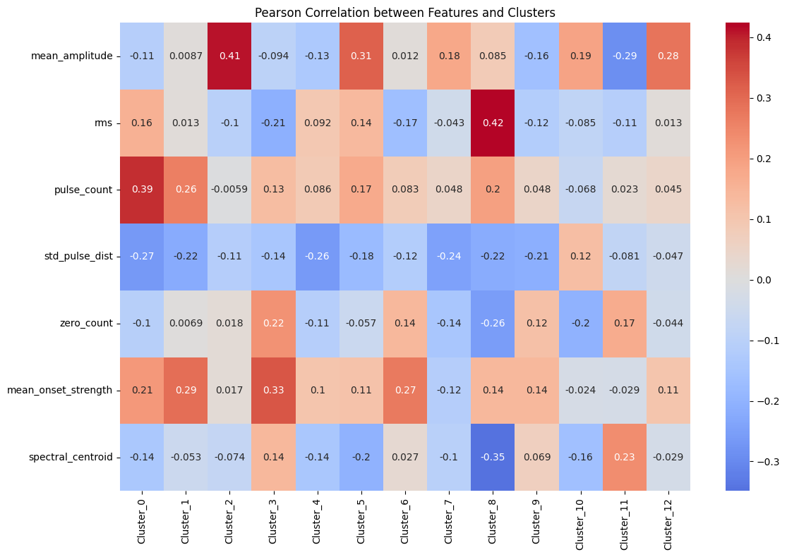
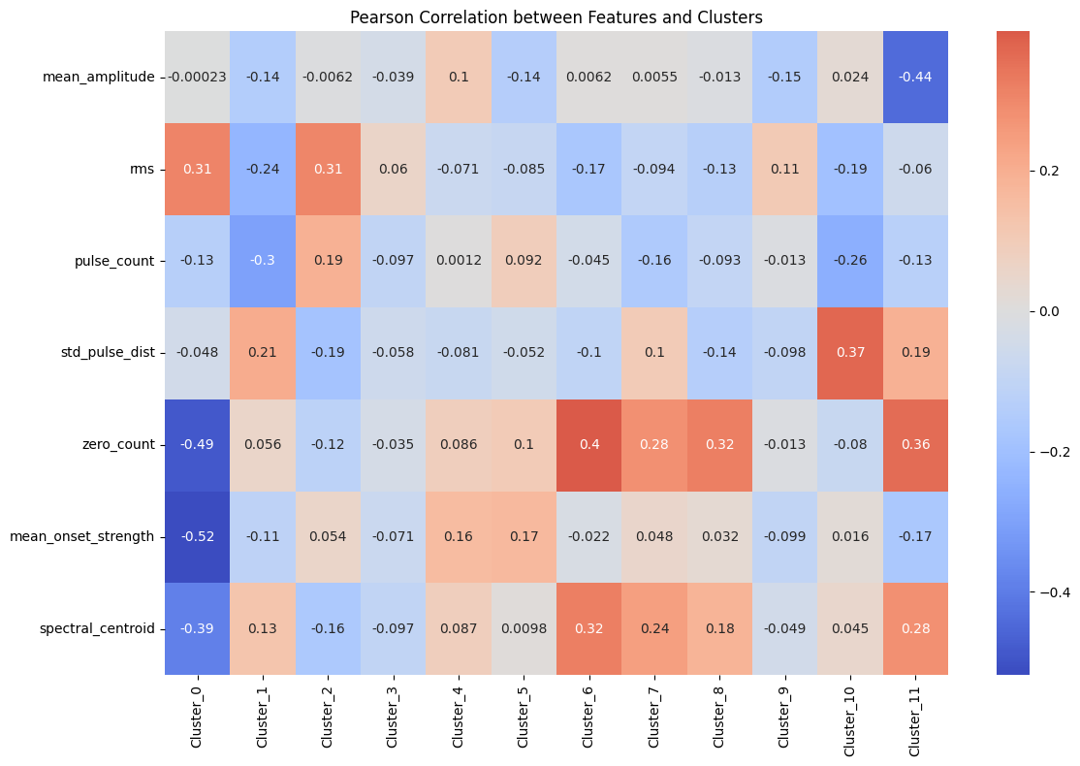
Word2Vec-after2
Positive
Negative

Slide 28
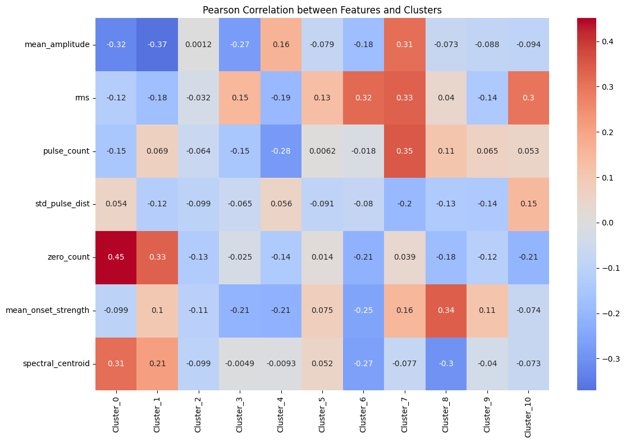
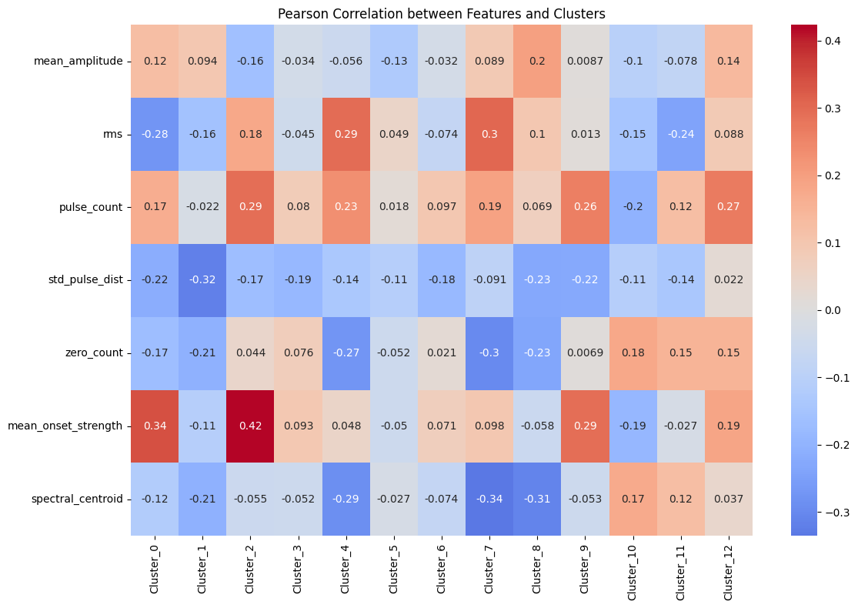
FastText-before
Positive
Negative

Slide 29
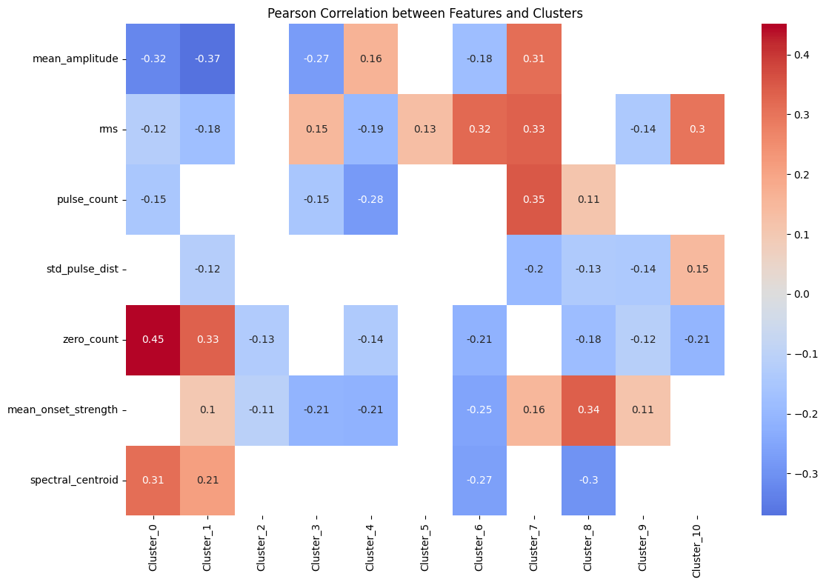
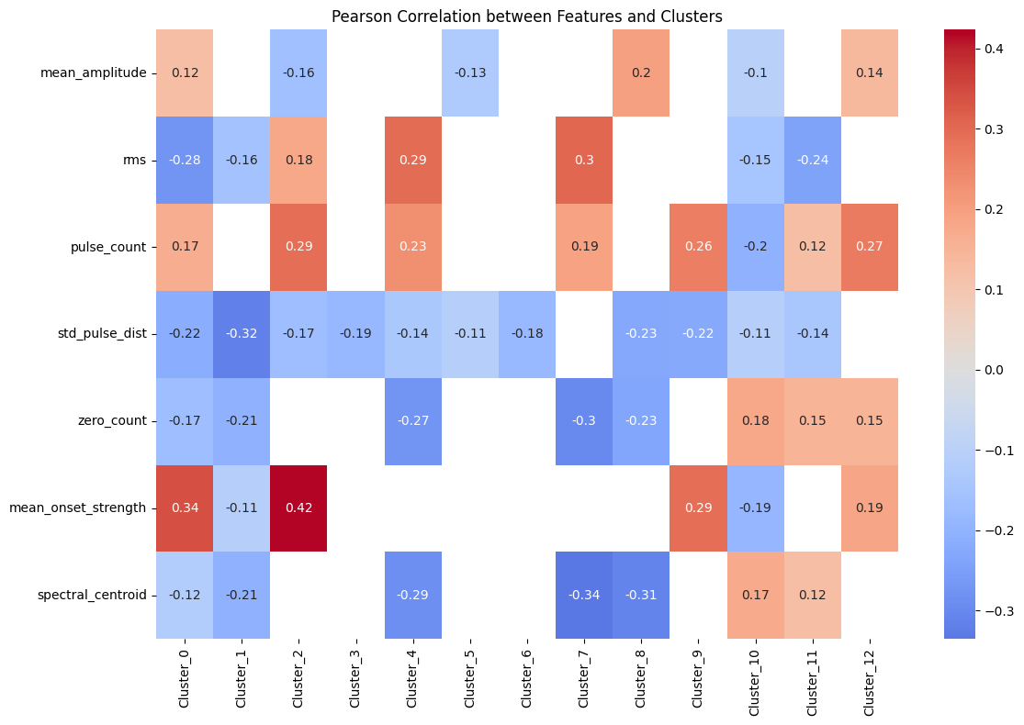
FastText
Positive
Negative

Slide 30
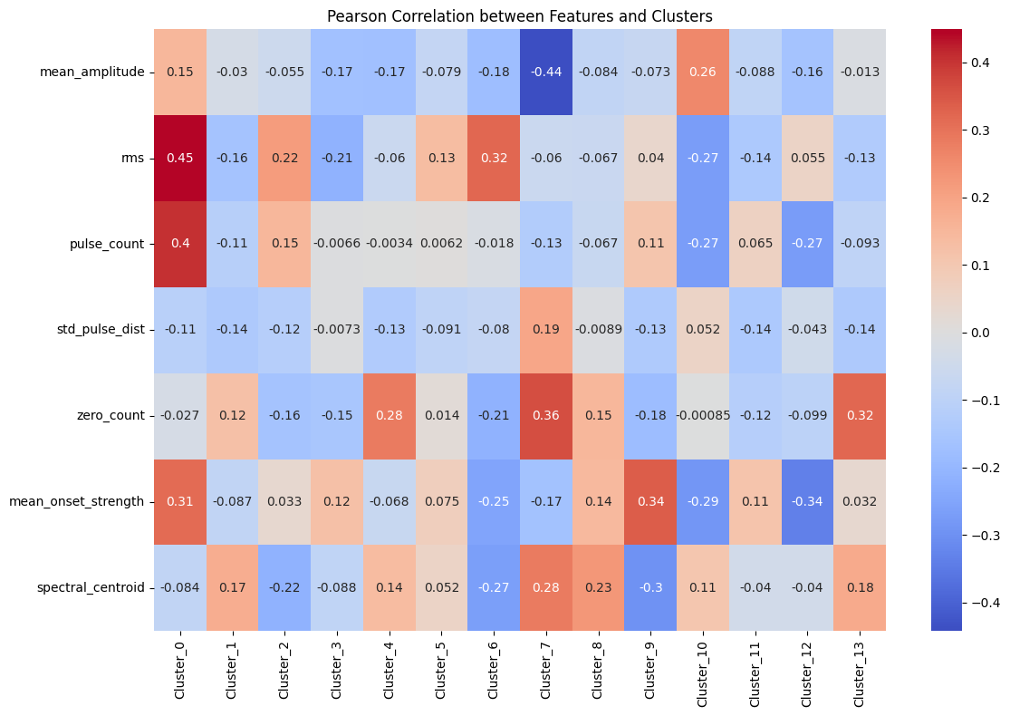
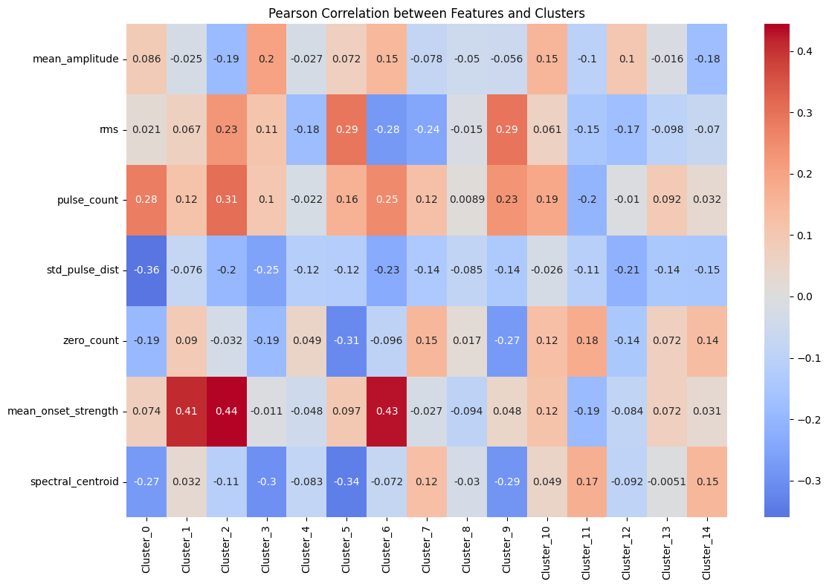
FastText-after1
Positive
Negative

Slide 31
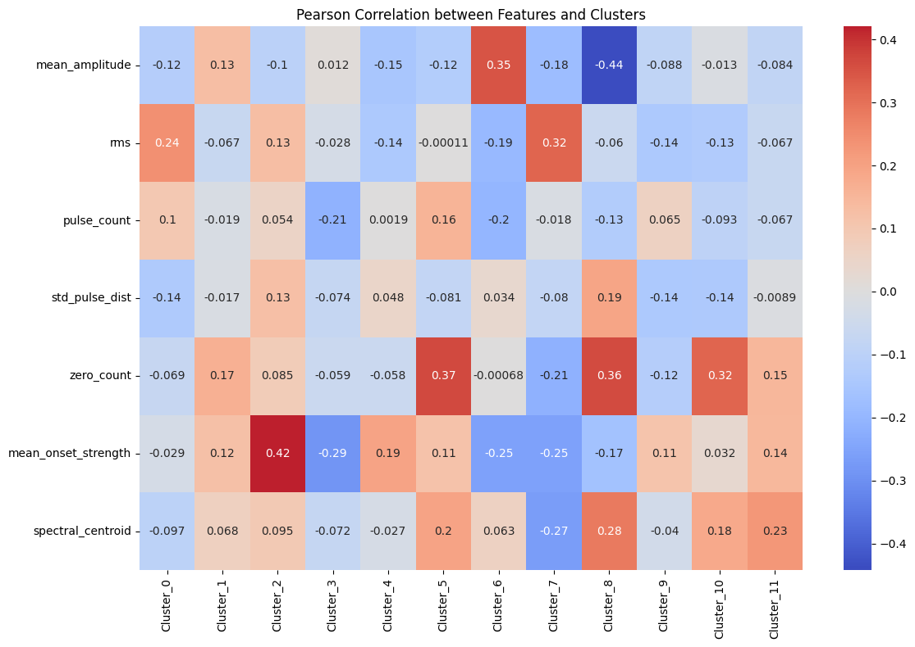
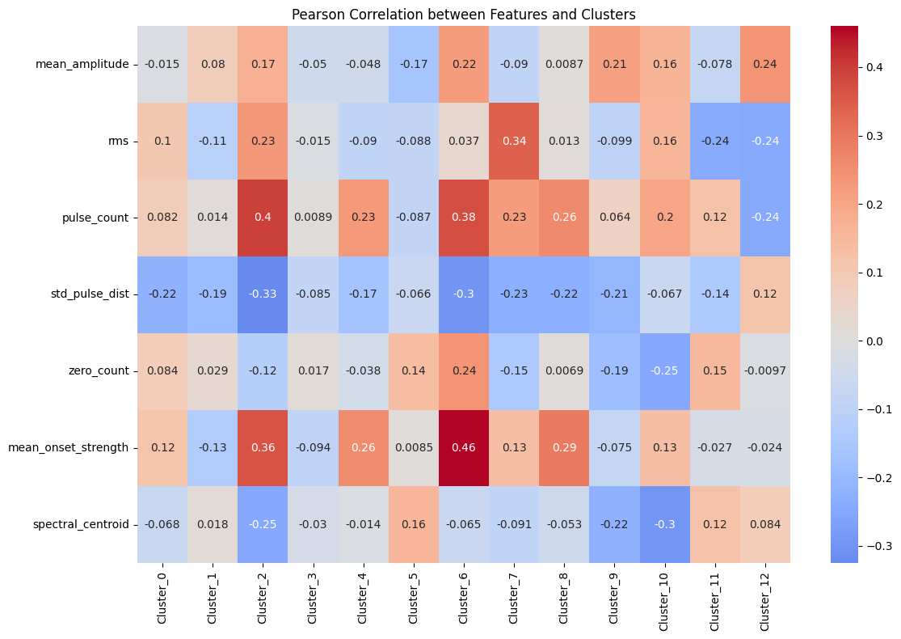
FastText-after2
Positive
Negative

Slide 32
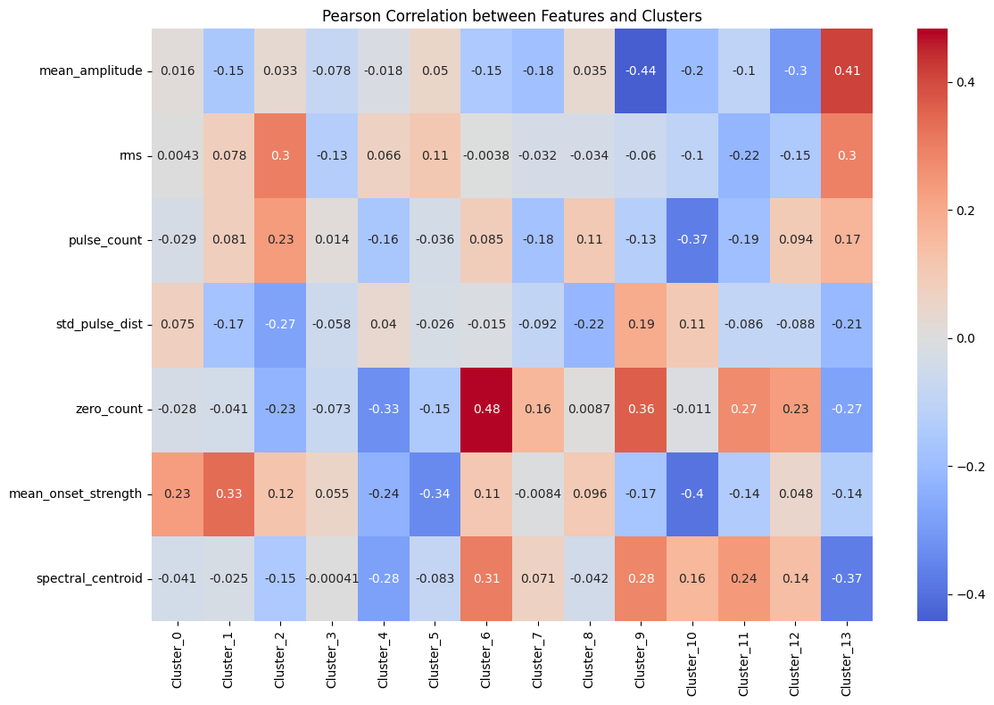
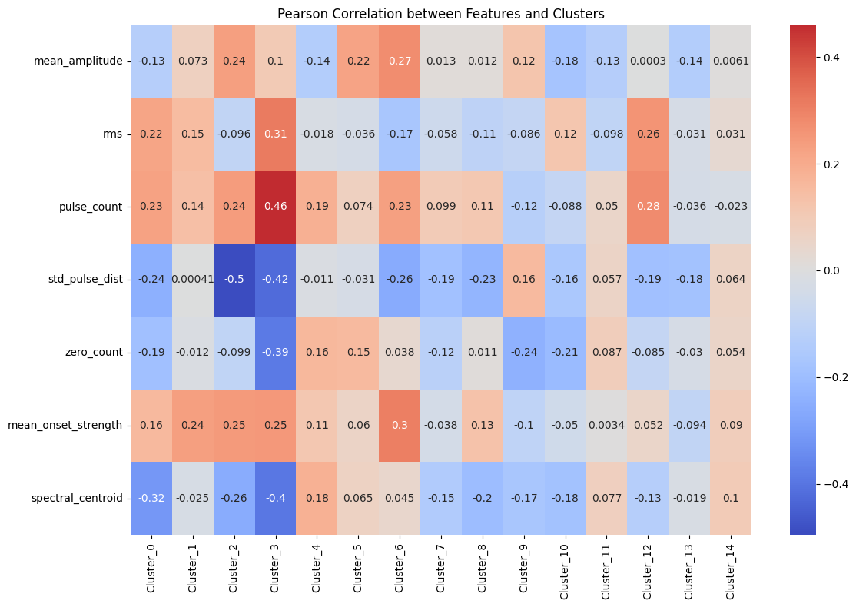
ConceptNet Numberbatch
Positive
Negative

Slide 33
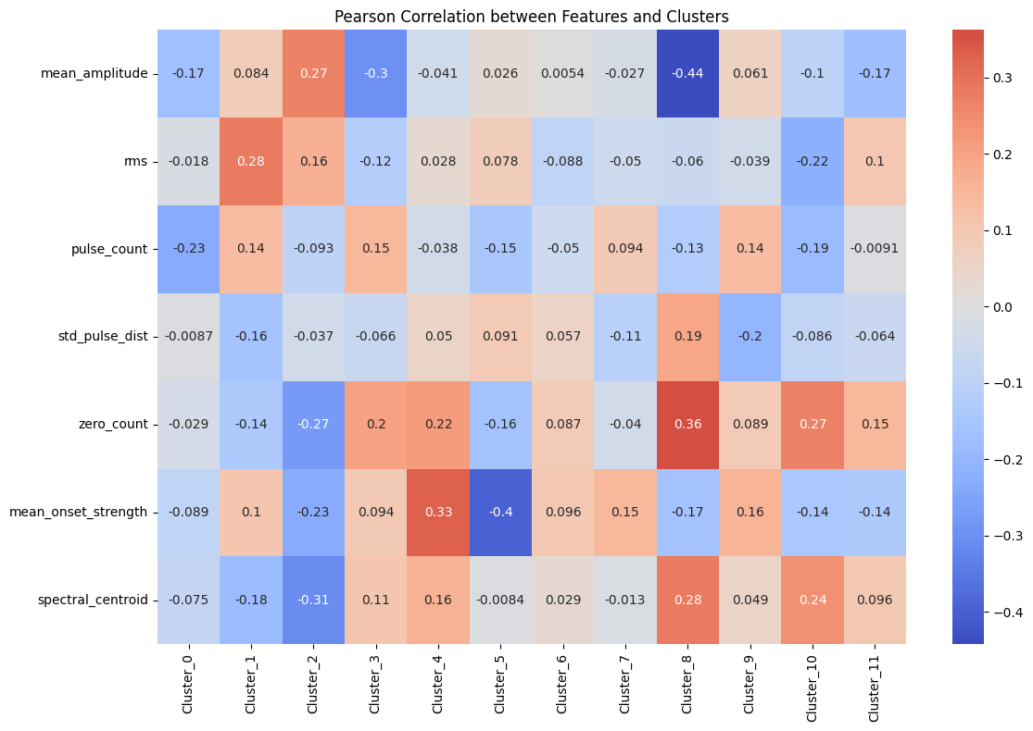
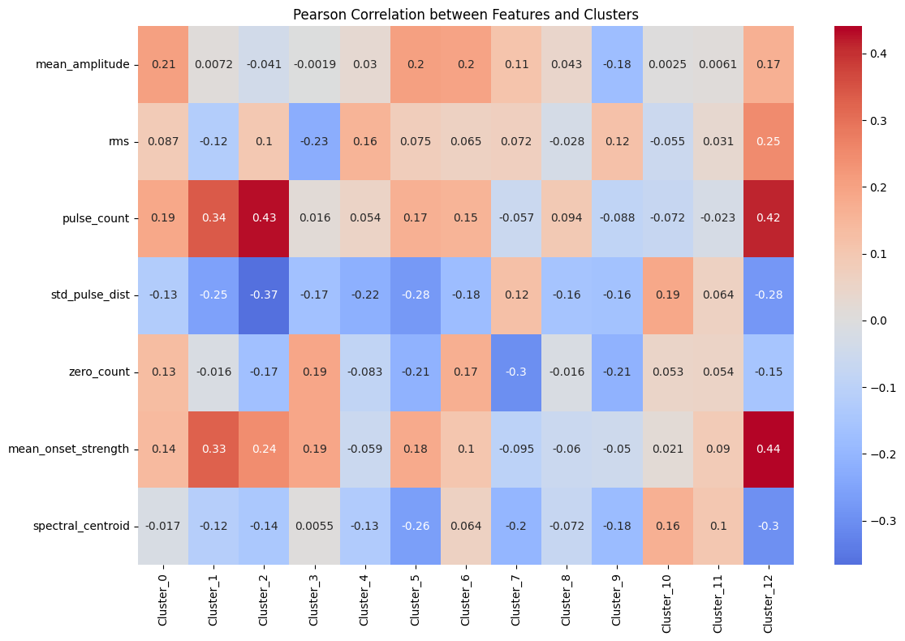
ConceptNet Numberbatch
Positive
Negative

Slide 34
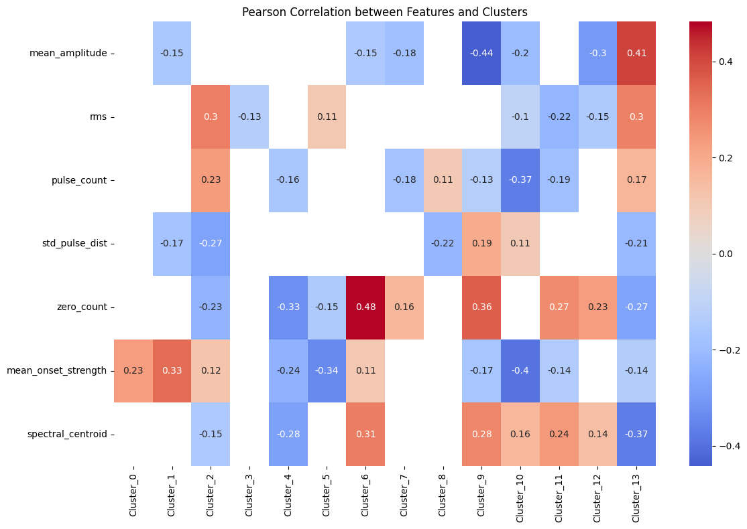
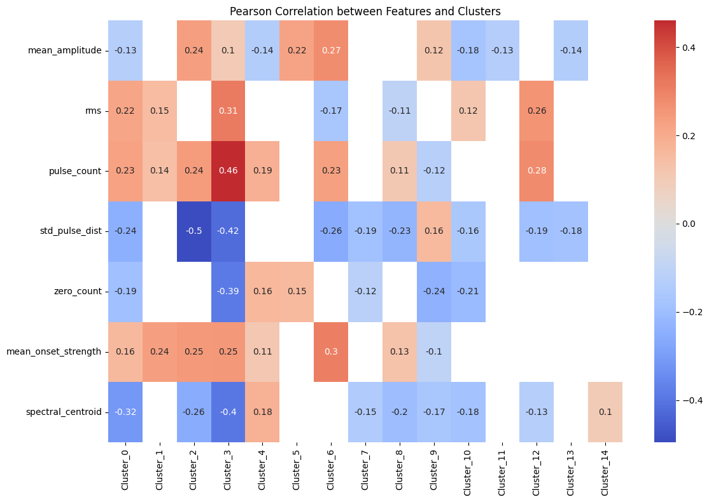
ConceptNet Numberbatch
Positive
Negative

Slide 35
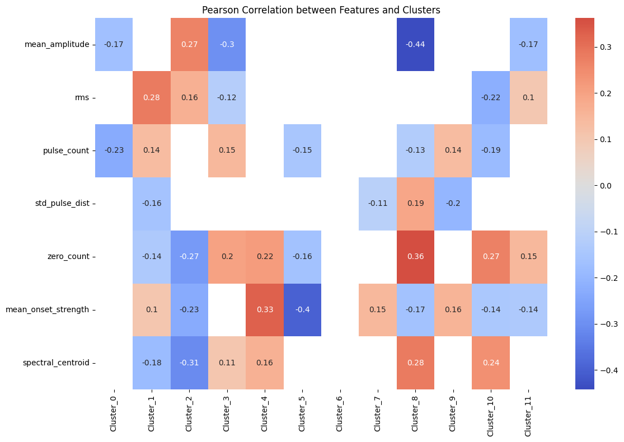

ConceptNet Numberbatch
Positive
Negative

Slide 36
Compare the trend

Slide 37



Slide 38


Step 6: Feature visualization according to Ratio of positive and negative

Slide 39


Step 6: Feature visualization according to Ratio of positive and negative

Slide 40


Step 6: Feature visualization according to Ratio of positive and negative

Slide 41

Step 6: Feature visualization according to Ratio of positive and negative

Slide 42

Step 7: Cosine similarity between different clusters
Cosine similarity>=0.7
GloVe Positive:
1&7

Slide 43

Step 7: Cosine similarity between different clusters
Cosine similarity>=0.7
GloVe Negative:
0&5 5&9 5&14

Slide 44

Step 7: Cosine similarity between different clusters
Cosine similarity>=0.7
Word2Vec Positive:

Slide 45

Step 7: Cosine similarity between different clusters
Cosine similarity>=0.7
Word2Vec Negative:

Slide 46

Step 7: Cosine similarity between different clusters
Cosine similarity>=0.7
FastText Positive:
1&2 1&4 1&12 3&4

Slide 47

Step 7: Cosine similarity between different clusters
Cosine similarity>=0.7
FastText Negative:
0&2 0&5 5&13

Slide 48

Step 7: Cosine similarity between different clusters
Cosine similarity>=0.7
ConceptNet Numberbatch
Positive:

Slide 49

Step 7: Cosine similarity between different clusters
Cosine similarity>=0.7
ConceptNet Numberbatch
Negative:

Slide 50
Next Steps
Find other advanced methods to explore the relationship between signal features and word categories.
Cluster phrases - perhaps Bert can be used.

